Slide 1

MASTER ASP.NET CORE MVC
Bhrugen Patel

Slide 2
ASP.NET Evolution
ASP.NET Webform
ASP.NET Core
ASP.NET Core 3, 3.1
1996
2002
2009
2016
2017
Q4 -2019
ASP
ASP.NET MVC
ASP.NET Core 2

Slide 3
Advantages of ASP.NET Core
ASP.net core is no longer dependent on IIS.
There is also a unification between MVC and Web API.
Dependency injection is an integral part of ASP.NET Core.
ASP.NET Core has a modular request pipeline.
Nuget has also been integrated deeply into ASP.NET Core.
ASP.NET Core is fully open source and cross platform

Slide 4
ASP.NET Pipeline
Browser
Auth
MVC
Static Files
Request
Response

Slide 5
ASP.NET CORE Request Processing
Browser
Request
IIS
dotnet
Application
Response
Kestrel

Slide 6
MVC Architecture
MVC Architecture separates the application into three main components
Model
View
Controller

Slide 7
Model
The model represents the data, and does nothing else.
The model is independent of the controller or the view.
Menu Item
Category
Order Header
Order Detail

Slide 8

View
Views are the components that display the application's user interface (UI).
Typically, this UI is created from the model data.

Slide 9

Controller
Controllers are the components that handle user interaction (HTTPRequest)
Controller works with the model, and ultimately select a view that displays UI

Slide 10
MVC Architecture
Model
Update Data
Get Data
Web Request
Controller
View
Update UI

Slide 11
Dependency Injection
ASP.NET Core is designed from scratch to support Dependency Injection.
NET Core injects objects of dependency classes through constructor or method by using built-in IoC container.
Dependency Injection (DI) is a pattern that can help developers decouple the different pieces of their applications.
In ASP.NET Core, both framework services and application services can be injected into your classes, rather than being tightly coupled.

Slide 12






Dependency Injection Example

Slide 13
Without Dependency Injection
EMAILS
LOGS
DATABASE

Slide 14
With Dependency Injection
EMAILS
LOGS
CONTAINER
DI
DATABASE

Slide 15
Tag Helpers
Tag Helpers are introduced with ASP.NET Core.
Tag Helpers enable server-side code to participate in creating and rendering HTML elements in Razor files.
Tag Helpers are very focused around the html elements and much more natural to use.

Slide 16
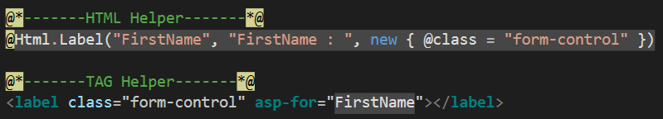
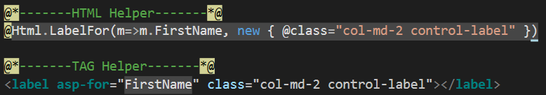
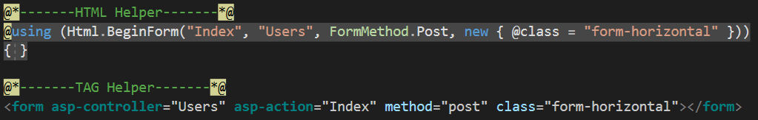
Tag Helpers Example

Slide 17
Razor Pages
Introduced in asp.net core 2.0
Razor Pages is a new feature of ASP.NET Core MVC that makes coding page-focused scenarios easier and more productive
Razor pages is not just for simple scenarios, everything that you can do with MVC you can do by using Razor pages like Routing, Models, ActionResult, Tag Helpers and so on.

Slide 18

Routing in Razor Pages
Routing in Asp.net Razor pages maps URL’s to Physical file on disk.
Razor pages needs a root folder.
Index.cshtml is a default document
URL | Maps To
www.domain.com | /Pages/Index.cshtml
www.domain.com/index | /Pages/Index.cshtml
www.domain.com/account | /Pages/account.cshtml /Pages/account/index.cshtml

Slide 19
Routing in MVC
Response
404
Error
URL
Request
Routing Engine
Route Table
No
URL matches
with configured Routes?
Route 1 | URL Pattern | Handler
Route 2 | URL Pattern | Handler
Route 3 | URL Pattern | Handler
Yes
Execute
Controller and Action method

Slide 20
URL Pattern in MVC
The URL pattern is considered only after domain name part in the URL.
Localhost:1234/{controller}/{action}/{id}
Localhost:1234/Book/Index/2

Slide 21
URL Pattern - Service
The URL pattern is considered only after domain name part in the URL.
Localhost:1234/{controller}/{action}/{id}
Localhost:1234/Book/Index/2
Anything after “localhost:1234/” would be considered as controller name
The same way, anything after controller name would be considered as action name
Lastly anything after action name is value of the id parameter

Slide 22
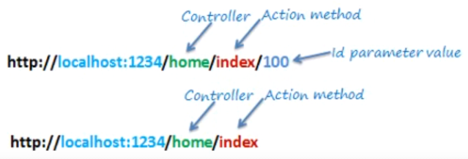
Routing Examples in MVC
URL | Controller | Action | Id
http://localhost/home | Home | Index | Null
http://localhost/home/index/123 | Home | Index | 123
http://localhost/home/about | Home | About | Null
http://localhost/home/contact | Home | Contact | Null
http://localhost/book | Book | Index | Null
http://localhost/book/edit/123 | Book | Edit | 123

Slide 23
wwwroot
Static files are stored within your project's web root directory.
The default directory is <content_root>/wwwroot.
Configure the middleware which enables the serving of static files.

Slide 24
Startup.cs
The Startup class configures services and the app's request pipeline.
The startup class include ConfigureServices method to configure the app's services even though this is optional.
The startup class includes a Configure method to create the app's request processing pipeline which is mandatory.

Slide 25
AppSettings.json
All of the application's settings are contained in a file named appsettings.json.
Any changes to the appsettings.json file will require restarting the "Microsoft IIS Administration" service to take effect.

Slide 26
LaunchSettings.json
This file sets up the different launch environments that Visual Studio can launch automatically.
Using launchsettings features, we can:
Create and use custom environments.
Enable or disable application services based on the environment the app is running in.
Use the environment tag helper (<environment>) to modify our MVC views based on the current execution environment.

Slide 27
Action Result
ActionResult is a result of action methods or return types of action methods
Action result is a parent class for many of the derived classes that have associated helpers.
The IActionResult return type is appropriate when multiple ActionResult return types are possible in an action.

Slide 28
Action Result in Razor Pages
ActionResult | Helper | Description
ContentResult | Content | Takes a string and returns it with a text/plaincontent-type header by default. Overloads enable you to specify the content-type to return other formats such as text/html or application/json, for example.
FileContentResult | File | Returns a file from a byte array, stream or virtual path.
NotFoundResult | NotFound | Returns an HTTP 404 (Not Found) status code indicating that the requested resource could not be found.
PageResult | Page | Will process and return the result of the current page.
PartialResult | Partial² | Returns a Partial Page.
RedirectToPageResult | RedirectToPage RedirectToPagePermanent RedirectToPagePreserveMethod RedirectToPagePreserveMethodPermanent | Redirects the user to the specified page.
ViewComponentResult |  | Returns the result of executing a ViewComponent.

Slide 29
Action Result in MVC
Action Result | Helper Method | Description
ViewResult | View | Renders a view as a Web page.
PartialViewResult | PartialView | Renders a partial view, which defines a section of a view that can be rendered inside another view.
RedirectResult | Redirect | Redirects to another action method by using its URL.
RedirectToRouteResult | RedirectToAction RedirectToRoute | Redirects to another action method.
ContentResult | Content | Returns a user-defined content type.
JsonResult | Json | Returns a serialized JSON object.
JavaScriptResult | JavaScript | Returns a script that can be executed on the client.
FileResult | File | Returns binary output to write to the response.
EmptyResult | (None) | Represents a return value that is used if the action method must return a null result (void).

Slide 30
What we covered?
Introduction and advantages of ASP.NET MVC Core 2.0
Folder structure and new files with asp.net core 2.0
Fundamentals of ASP.NET Core : Routing, Action Result, Tag Helpers etc.
Project 1 : CRUD Operations using ASP.NET MVC Core 2.0
Introduction to Razor Pages in ASP.NET MVC Core 2.0
Project 2 : CRUD Operations , ASP.NET Core 2.0 using Razor Pages
Project 3 : Complex Car Service Record project using ASP.NET MVC Core 2.0

Slide 31
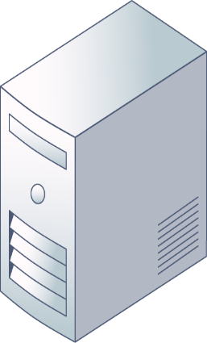

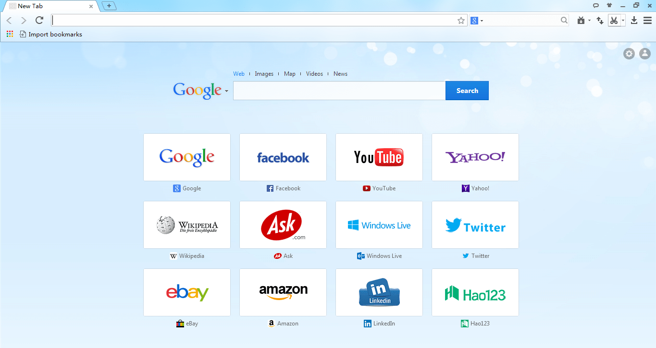

Middleware in ASP.NET Core
Context
-Request
-Response
ASP.NET Core
Request
Middleware

Slide 32
Middleware in ASP.NET Core
Context
-Request
-Response
Context
-Request
-Response
ASP.NET Core
Request
Middleware

Slide 33
Middleware in ASP.NET Core
Context
-Request
-Response
ASP.NET Core
Request
Middleware

Slide 34
Middleware in ASP.NET Core
Context
-Request
-Response
ASP.NET Core
Request
Response
Middleware

Slide 35
No global.asax anymore
The Main Method
Startup is defined by you
Main Method

Slide 36
Order Status
Shopping
Cart
01
Pending
When user submits order.
Shopping
Cart
02
Submitted
When orders payment goes through.
Manage Order
03
Being Prepared
When chef starts preparing the order.
Manage Order
04
Ready for Pickup
When chef completes the order and marks it as ready.
05
Completed
Pickup
When end user picks the order up from store.
Manage Order
06
Cancelled
Admin/Front Desk can cancel an order for any reason.

Slide 37
Website User Roles
Customer
Kitchen
Browse through items.
Register/Login using email, Facebook or Google.
Add Items to cart.
Apply coupons and place order using credit card.
View their order status.
Manage their account details.
View orders that are placed with their details.
Start cooking the order and update the system once they are prepared.
Everything Customers can do.
Front Desk
Manager(Admin)
View All the orders that are ready for pickup.
They can search through order history to see all the available orders.
Verify user details when they come in to pick up the order and update status to order completed.
Everything Customers can do.
Manage Website Content
Category
Sub Category
Menu Item
Coupons
Users
Everything Front Desk, Kitchen and Customer can do.

Slide 38
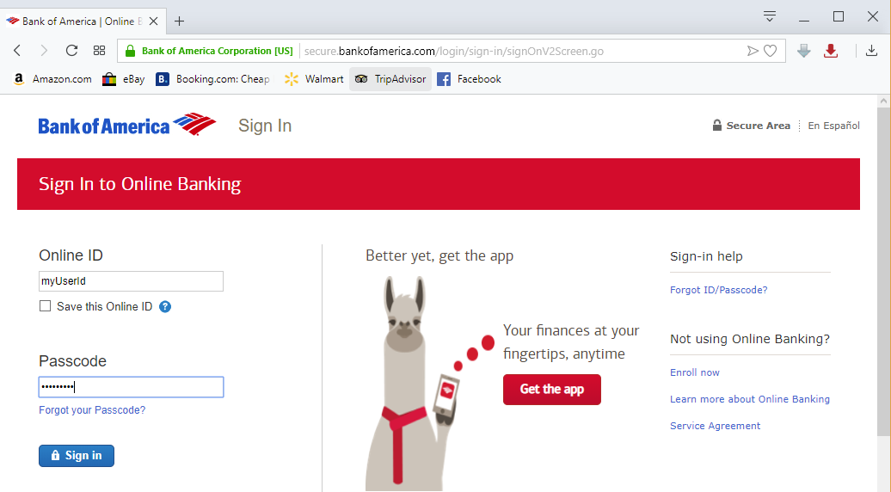


Cross-Site Request Forgery
Cross-site request forgery (also known as XSRF or CSRF), is an attack against web-hosted apps whereby a malicious web app can influence the interaction between a client browser and a web app that trusts that browser.
Dan

Slide 39
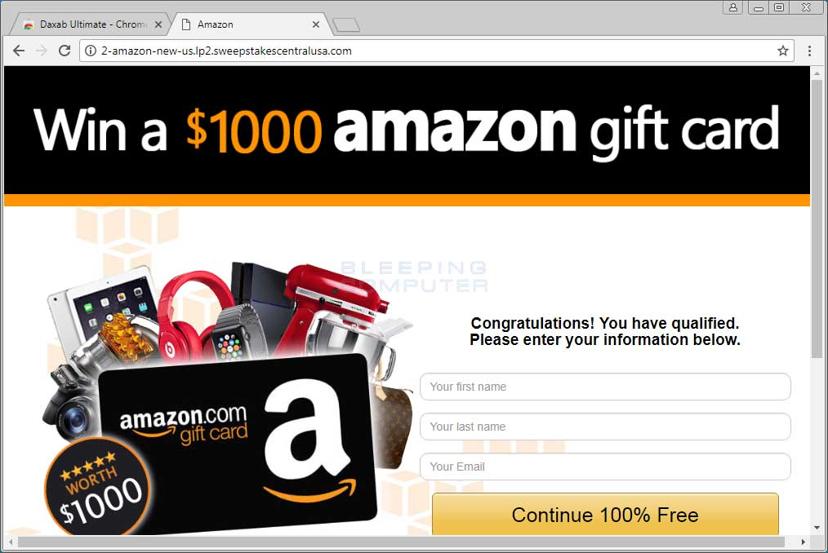

Cross-Site Request Forgery
Once Bob hits ‘Continue’ button
Browser makes request and automatically includes cookie for requested domain.
The request runs on the Good Bank server with user’s authentication and it can perform transactions without the knowledge of the user.
Dan
<h1>Win a $1000 amazon gift card</h1>
<form action="http://good-banking-site.com/api/account" method="post">
<input type="hidden" name="Transaction" value="withdraw">
<input type="hidden" name="Amount" value="1000000">
<input type="submit" value="Click to collect your prize!">
</form>

Slide 40
Cross-Site Request Forgery
GET requests that change state are insecure.
CSRF attacks are possible against web apps that use cookies for authentication.
CSRF is also vulnerable when multiple apps hosted at one domain (example1.cost.net, example2.cost.net)
CSRF vulnerabilities are fundamentally a problem with the web app, not the end user

Slide 41
Cross-Site Request Forgery - Service
GET requests that change state are insecure. A best practice is to never change state on a GET request.
CSRF attacks are possible against web apps that use cookies for authentication because
Multiple apps hosted at one domain (example1.cost.net, example2.cost.net)
CSRF vulnerabilities are fundamentally a problem with the web app, not the end user

Slide 42
How ASP.NET core Helps
Antiforgery Token
In ASP.NET Core 2.0 or later, the FormTagHelper injects antiforgery tokens into HTML form elements.
This applies by default if the forms method is not GET.
The following markup automatically generates antiforgery tokens:
<form method="post"> ... </form>
How it works?
The server sends a token associated with the current user's identity to the client.
The client sends back the token to the server for verification.
If the server receives a token that doesn't match the authenticated user’s identity, the request is rejected.

Slide 43
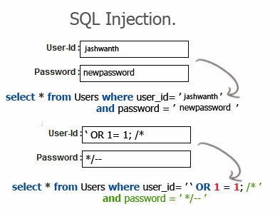
SQL Injection Attacks
SQL injection is a code injection technique that might destroy your database.
SQL injection is one of the most common web hacking technique
SQL injection is the placement of malicious
code in SQL statements, via web page input.

Slide 44
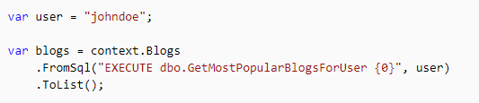
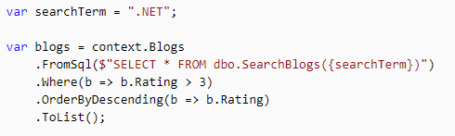
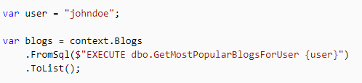
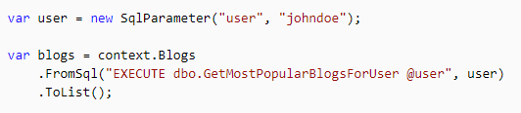
SQL Injection Attacks
Entity Framework Core allows you to drop down to raw SQL queries when working with a relational database.

Slide 45
Cross-Site Scripting (XSS)
Cross site scripting (XSS) is a common attack vector that injects malicious code into a vulnerable web application.
XSS differs from other web attack vectors (e.g., SQL injections), in that it does not directly target the application itself. Instead, the users of the web application are the ones at risk.

Slide 46
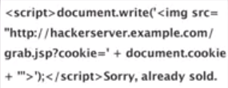
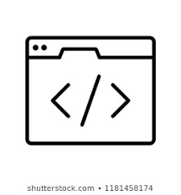








Cross-Site Scripting (XSS) Example
Vulnerable website
ATTACKER
Injects malicious script
User requests data from the server
Malicious script is saved to database
Data containing malicious script is loaded
VICTIM
Server
Malicious script might be executed and data would be sent to attacker

Slide 47
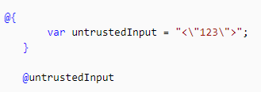

How to prevent XSS
HTML Encoding using Razor
Validation as an XSS prevention technique
Cshtml Code
Ouput

Slide 48
Open Redirect Attacks in ASP.NET Core
A web app that redirects to a URL that's specified via the request such as the query string or form data can potentially be tampered with to redirect users to an external, malicious URL. This tampering is called an open redirection attack.
ASP.NET Core has built-in functionality to help protect apps from open redirect (also known as open redirection) attacks.

Slide 49
Open Redirect Example
The malicious user convinces the user to click a link to a site's login page with a return URL
query string value added to the URL.
Consider an app at contoso.com that includes a login page at
http://contoso.com/Account/LogOn?returnUrl=/Home/About.
The attack follows these steps:
The user clicks a malicious link to
http://contoso.com/Account/LogOn?returnUrl=http://contoso1.com/Account/LogOn
(the second URL is "contoso1.com", not "contoso.com").
2. The user logs in successfully.
3. The user is redirected (by the site) to http://contoso1.com/Account/LogOn (a malicious
site that looks exactly like real site).
4. The user logs in again (giving malicious site their credentials) and is redirected back to
the real site.
The user likely believes that their first attempt to log in failed and that their second attempt is successful. The user most likely remains unaware that their credentials are compromised.

Slide 50
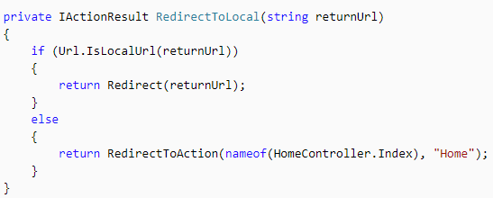

Protecting Against Open Redirection
If your application has functionality that redirects the user based on the contents of the URL, ensure that such redirects are only done locally within your app (or to a known URL, not any URL that may be supplied in the query string).
Use the LocalRedirect helper method from the base Controller class
Use the IsLocalUrl method to test URLs before redirecting.

Slide 51
Repository Pattern
It provides an abstraction of data.
Benefits of Repository Pattern
Minimize duplicate logic.

Slide 52
Repository Pattern
It provides an abstraction of data.
Benefits of Repository Pattern
Minimize duplicate logic.
It decouples your application from persistence frameworks.

Slide 53
Traditional Approach
var CategorySelectList = _db.Category.Select(i => new SelectListItem()
{
Text = i.Name,
Value = i.Id.ToString()
});
Repository Pattern
var CategorySelectList = _repository.GetCategoryListForDropDown();

Slide 54
Repository
Get(id)
GetAll(param1, param2…)
GetFirstOrDefault(param1, param2..)
Add(obj)
Remove(obj)

Slide 55
Unit Of Work
The unit of work class coordinates the work of multiple repositories by creating a single database context class shared by all of them.
Unit of Work
Entity Framework and Database
Controller
Repository
Repository
DbContext

Slide 56
DbSet
DbContext
Add(obj)
Remove(obj)
Find(id)
FirstOrDefault(expression)
Where(expression)
DbSet
DbSet
DbSet
SaveChanges()
Repository
Unit of work

Slide 57
DbSet/DbContext
Application
Entity Framework
Repository Pattern
Application
Repository
GetCategoryListForDropDown(…)
Entity Framework

Slide 58
IRepository
Repository
IUnitOfWork
UnitOfWork
Create Repository Interface
ICategoryRepository
Implement Repository Interface
CategoryRepository
Add Property in IUnitOfWork
IUnitOfWork
Set Property in UnitOfWork
UnitOfWork
New Method declaration not present in IRepository
Contains method implementation/definition for ICategoryRepository
Create object for ICategoryRepository in IUnitOfWork
Assign DbContext and Set the properties in IUnitOfWork

Slide 59
IUnitOfWork
Category
OrderHeader
Save()
UnitOfWork
Order Header
Generic
Category
IOrderHeaderRepository
IRepository
ICategoryRepository
Add(obj)
Remove(obj)
Find(id)
FirstOrDefault(expression)
GetAll(expression)
GetCategoryListForDropDown()
OrderHeaderRepository
Repository
CategoryRepository

Slide 60
UnitOfWork
IUnitOfWork
IOrderHeaderRepository OrderHeader { get; }
IOrderDetailsRepository OrderDetails { get; }
Void Save();

Slide 61
1.
Introduction

Slide 62
1.
Introduction

Slide 63
2.
Project
Designing

Slide 64
3.
Repository
Pattern

Slide 65
4.
Category
CRUD

Slide 66
5.
Frequency
CRUD

Slide 67
6.
Service
CRUD

Slide 68
7.
Home Page

Slide 69
8.
Details

Slide 70
9.
Shopping Cart and Order’s

Slide 71
10.
Admin
Registration

Slide 72
11.
Order
Management

Slide 73
12.
Authorization

Slide 74
13.
Stored
Proecdure

Slide 75
14.
Image
Uploader

Slide 76
15.
Data Seeding

Slide 77
16.
Deployment

Slide 78
Security in
ASP.NET Core

Slide 79
ASP.NET Core 3
Web Development
MVC (Model-View-Controller)
Master ASP.NET Core MVC Series
Razor Pages
Master ASP.NET Core Razor Series

Slide 80
Master ASP.NET Core
MVC Series
Introduction to ASP.NET Core 2.2
(Beginner)
Master ASP.NET Core 2.2 – MVC
(Intermediate)
Advanced ASP.NET Core 3 – MVC
(ADVANCED)

Slide 81
Master ASP.NET Core
Razor Series
Introduction to ASP.NET Core 2.2
(Beginner)
Master ASP.NET Core 2.2 - Razor Pages
(Intermediate)
Advanced ASP.NET Core 3 – Razor Pages
(ADVANCED)

Slide 82
Advanced ASP.NET
Core 3 - RAZOR
-Bhrugen Patel

Slide 83
Course Overview
Repository Pattern
N-tier Architecture
Stored Procedures using Dapper
Sessions in ASP.NET Core
Data tables with API
Authentication / Authorization
Identity in ASP.NET Core
Stripe Payment Gateway
Data Seeding
Deployment to Azure

Slide 84
GETTING HELP
Check Questions
Raise Questions
Google
GitHub

Slide 85
Course Overview
Repository Pattern
N-tier Architecture
Stored Procedures
Sessions in ASP.NET Core
Data tables with API
Authentication / Authorization
Identity in ASP.NET Core

